Slide 1
Visualisation tools

Slide 2
Using R

Slide 3
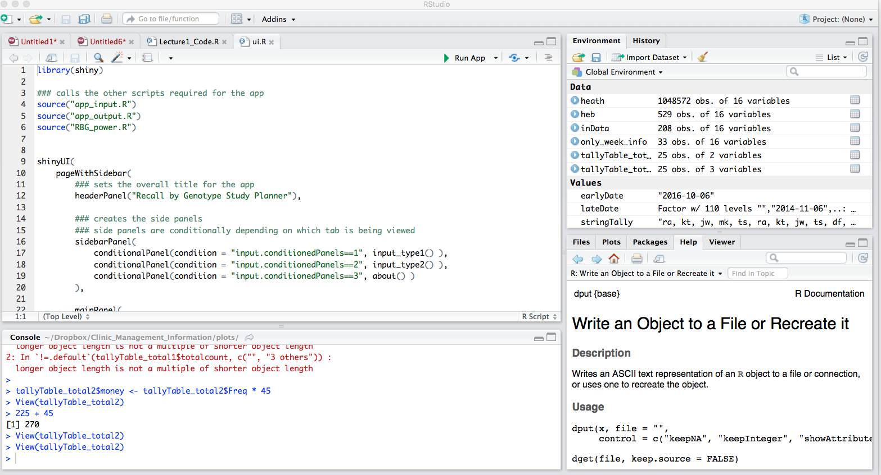
R Studio
Code Editor
Workspace
History
Plots
Files
Help
R Console

Slide 4
Assigning values to variables
A variable stores a value or an object
Use variable’s name to easily access the value or the object that is stored within this variable
Variable names can not contain spaces or special characters
<- used to assign values to variables
x <- 43
y <- “hello”

Slide 5
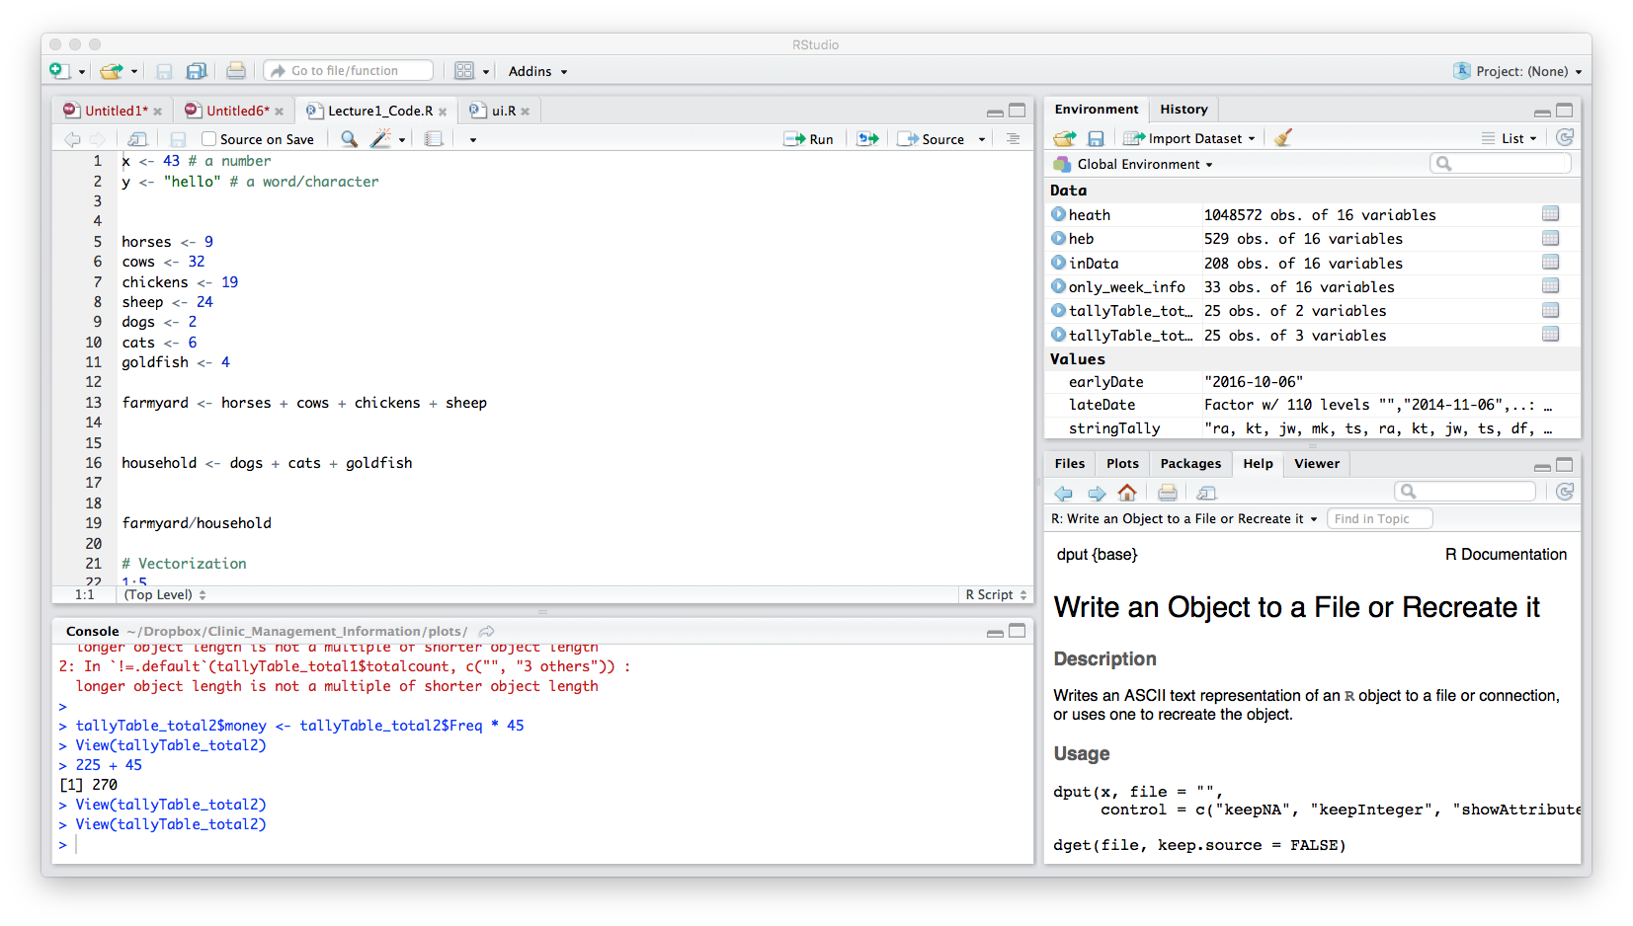
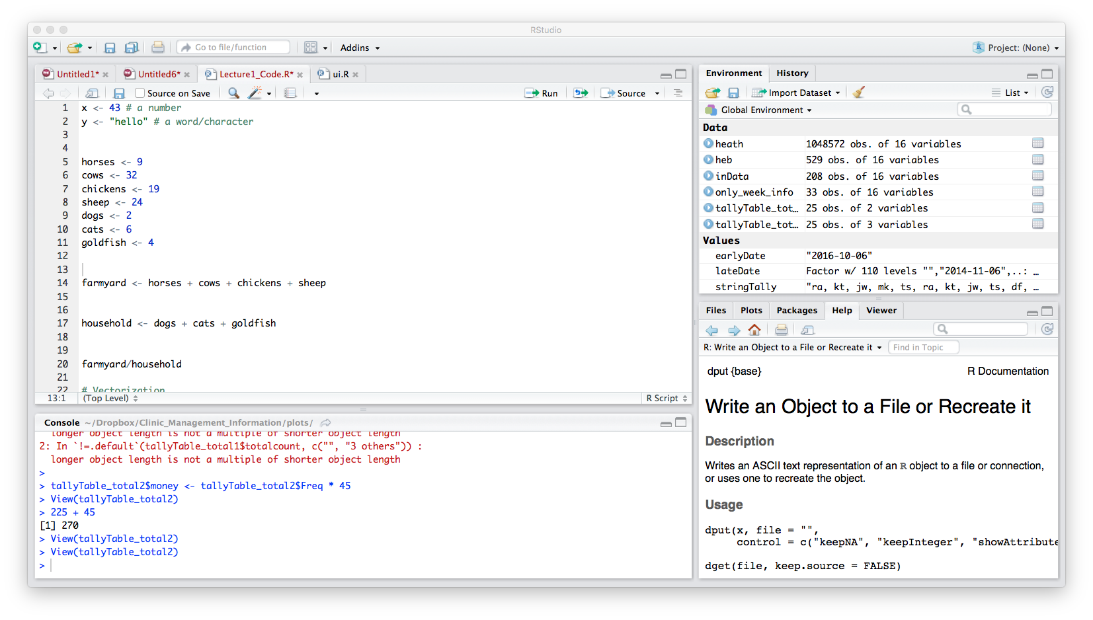
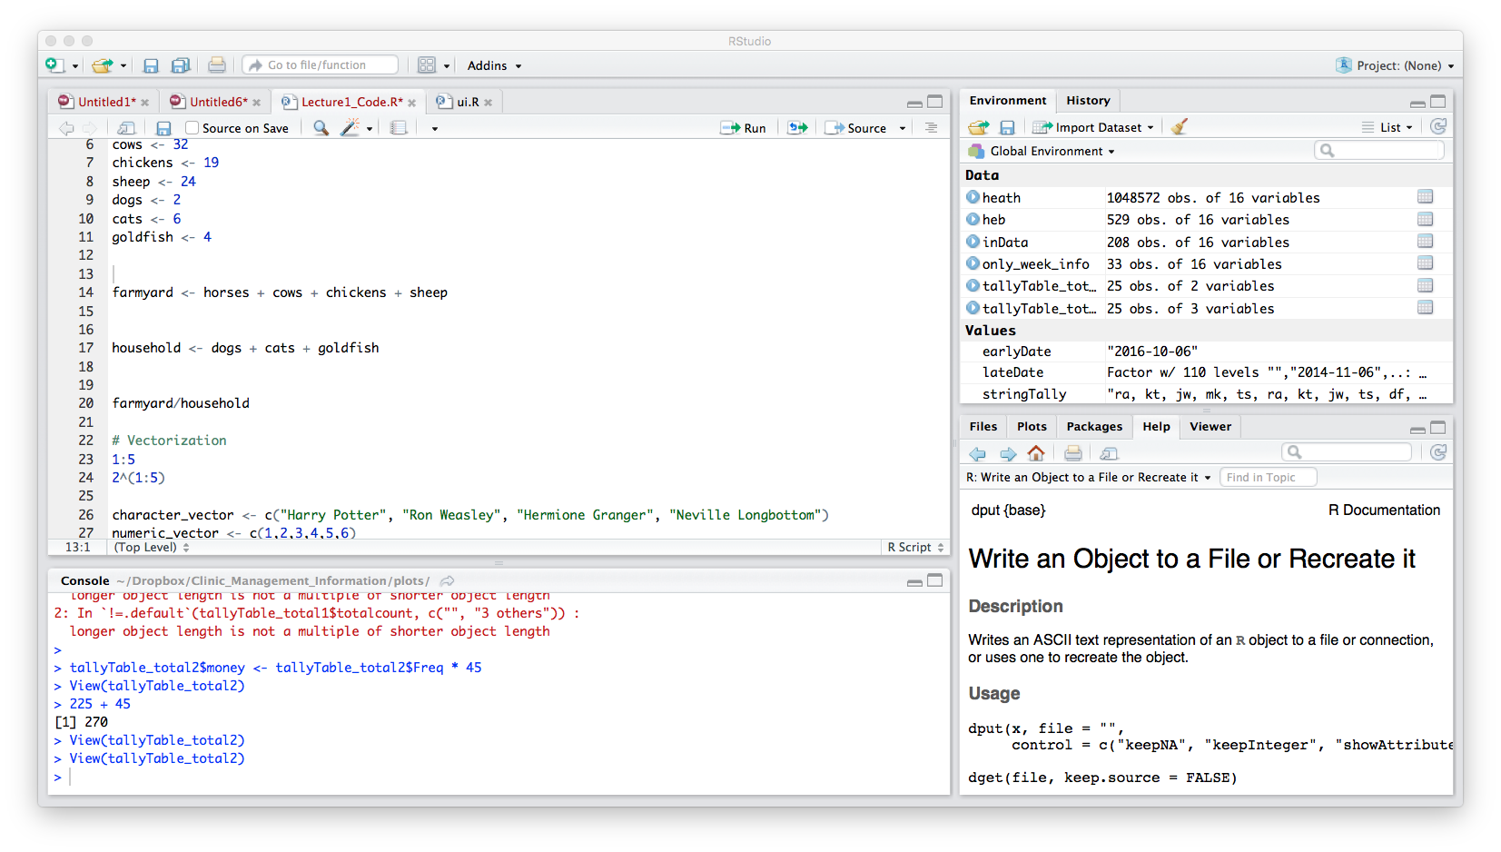
Variables can be used like values
How many farmyard animals are there?
How many house pets are there?
Ratio of farmyard animals to house pets

Slide 6
REMEMBER
Do not use spaces, quotes, special characters, or wildcard characters such as ‘*’ or ‘?’ in filenames, as it complicates variable expansion.
Give files consistent names that make logical sense, reflect what the data is and that are easy to match with wildcard patterns to make it easy to select them for looping.
THIS IS THE SAME AS WHEN WE TALK ABOUT UNIX!!!!

Slide 7
Tab completion!
RStudio will tab complete previously defined variable names
Very handy!
Particularly for longer variable names
Or complicated names
Because harder to get wrong if R is helping you complete the name
Remember with computers: You MUAT ALWAYS be completely precise in your instructions

Slide 8
R packages

Slide 9
R packages
Add functions to R
CRAN : https://cran.r-project.org/web/packages/available_packages_by_name.html
Bioconductor : http://bioconductor.org/packages/release/BiocViews.html#___Software

Slide 10
Working with R packages
installed.packages()
See what packages are installed
install.packages("packagename")
Install package “packagename”
NOTICE: must have quotes
update.packages()
Update installed packages
library(packagename)
Load a package/make it available for use
NOTICE: no quotes

Slide 11
PRACTICAL
Get and load the “GenomicRanges” package

Slide 12
Data Frames in R

Slide 13
Data Frame
Variables of a data set as columns and the observations as rows
Two-dimensional array
Similar to a matrix
Each column can have a different data type
as.data.frame()➔ change something into a dataframe
head() ➔ head of a data frame
tail() ➔ tail of a data frame
str() ➔ structure of data frame

Slide 14
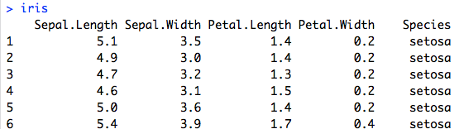
Data Frame
R counts from 1
Retrieve elements from a dataframe
iris[,2]
iris[4,]
iris[,“Species”]
iris$Species
iris[1:2,2]
iris[2:5,1:2]
iris[c(1,4,7), c(1,3)]

Slide 15
PRACTICAL
Data frames

Slide 16
Dataframe size
nrow()
Number of rows in the dataframe
dim()
Number of dimensions
Columns and rows
colnames()
Gets the column names of the dataframe

Slide 17
PRACTICAL
Data frames

Slide 18
Utilities

Slide 19
Useful built in functions
Don’t re-invent the wheel
Use the built-in functions
Built-in functions are written in C and are very fast
Faster than R
There are loads
http://www.statmethods.net/management/functions.html

Slide 20
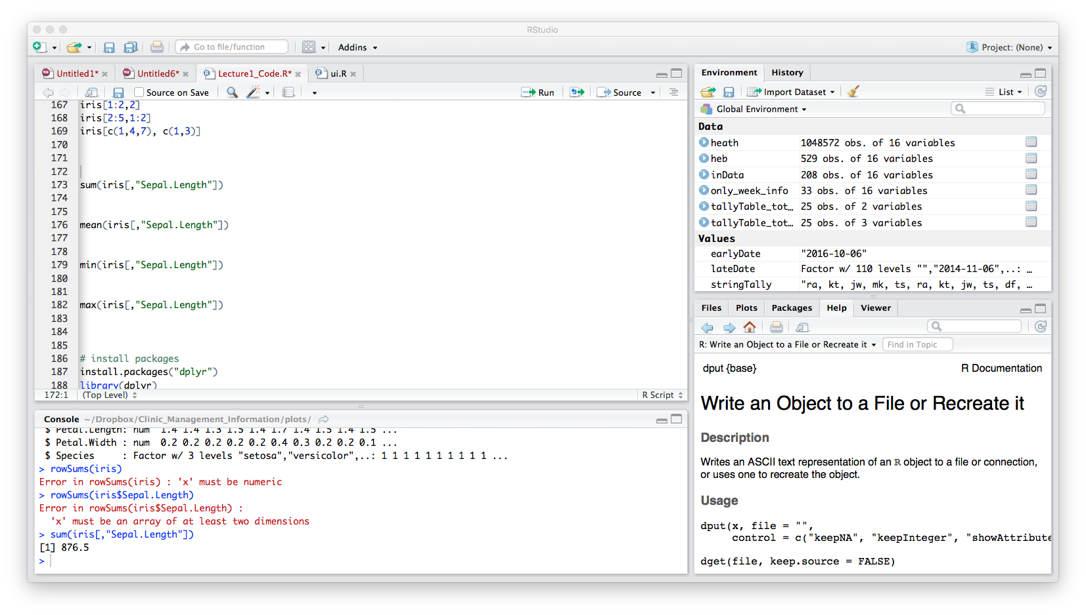
Sum, average, min, max
Sum of the column Sepal.Length
Average of the column Sepal.Length
Minimum value in column Sepal.Length
Maximum value in column Sepal.Length

Slide 21
PRACTICAL
Play with built in functions

Slide 22
Why are you making this plot?
Exploratory Data Analysis
Making plots for YOURSELF
Getting to know the data
Explanatory Data Analysis
Making plots for AUDIENCE
Communicate insights about the data

Slide 23
What information are you actually getting across?
Figure 2. Homologous alignments of 10 legume genomes with V. vinifera as a reference. Genomic paralogy, orthology, and outparalogy information within and among 10 legumes are displayed in 69 circles, each corresponding to an extant gene in Fig. 1B; The curved lines within the inner circle are formed by 19 grape chromosomes color-coded to correspond to the 7 ancestral chromosomes before the ECH. The short lines forming the innermost grape chromosome circles represent predicted genes, which have 2 sets of paralogous regions, forming another two circles. Each of the three sets of grape paralogous chromosomal regions has 2 orthologous copies in a legume with exception of soybean, which has 4. The resulting 69 circles were marked according to species by a capital letter, as defined in Fig. 1. Each circle has an underline colored as to its source plant corresponding to the color scheme in Fig. 1A and each circle is formed by short vertical lines that denote homologous genes, colored as to chromosome number in their respective source plant as shown in the inset color scheme.
Wang J, et al. Hierarchically aligning 10 legume genomes establishes a family-level genomics platform. Plant Physiology. DOI: https://doi.org/10.1104/pp.16.01981

Slide 24
Working with Human Perception
BEST
Position on a common scale
Position on identical but not aligned scales
Length
Angle
Slope
Area
Volume
Curve
Density
Color Saturation, Color Hue
WORST
Graphical Perception: Theory, Experimentation, and the Application to the Development of Graphical Methods. William Cleveland, Robert McGill, 1984

Slide 25
Working with Human Perception
Original study replicated recently (2010)
Start a plot with what humans are best at – POSITIONS
Use as a very last resort what humans are bad at
Color saturation, shading
Crowdsourcing Graphical Perception: Using Mechanical Turk to Assess Visualization Design. Jeffrey Heer and Michael Bostock, 2010.

Slide 26
Color Blindness
Varies by country, but around 7-10% of males are color blind
Most common is red-green
Easy to adapt color selection to be inclusive
Cookbook for R: http://www.cookbook-r.com/Graphs/Colors_(ggplot2)/#a-colorblind-friendly-palette

Slide 27
Color differentiation is hard
Hue → Color
Saturation → Colorfulness relative to brightness
Value → Lightness of color
Hues are good for categorical data
Some help : http://colorbrewer2.org/

Slide 28
Color for continuous variables isn’t always a good choice
Perception of color changes dependent on background
Means that depending on surround colors, different interpretations can occurs for the same color value

Slide 29
Heat maps are used
Prickrell J, et al. Detection and interpretation of shared genetic influences on 42 human traits. Nature Genetics. doi:10.1038/ng.3570
Papillon-Cavanagh S, et al. Impaired H3K36 methylation defines a subset of head and neck squamous cell carcinomas Nature Genetics 49, 180–185 (2017) doi:10.1038/ng.3757
Yoo H, et al. A recurrent inactivating mutation in RHOA GTPase in angioimmunoblastic T cell lymphoma. Nature Genetics. doi:10.1038/ng.2916

Slide 30
Visualization redundancy
What is color telling us?

Slide 31
Overplotting
Too many data points
Hard to see any information about density of data when all points are solid black dots
Information about the data becomes less clear with more data points

Slide 32
Reducing Overplotting
Size → smaller points are easier to see
Shape → Hollow circles objects are better
Jitter → adds random noise to x and y axis point
Makes it easier to see points that overlay
Alpha → alters the transparency
Allows you to see density

Slide 33
Data determines plot type
Not all graphs are appropriate for all data types
Eg. Scatter plotting categorical data, using line plots of unrelated non-times series data
Think about the data you have, and what you want to show

Slide 34
Diatribe about bar plots
Do not use bar plots to plot DISTRIBUTIONS
Plot individual data points!
Or maybe use a box plot or violin plot instead?
Or visual error? geom_errorbar?
This is a very good blog post about the issue:
http://www.eckmeier.de/?p=110

Slide 35
Annotating BED Files

Slide 36
Annotating BED files
There are many ways to do this:
BedTools
closest command : http://bedtools.readthedocs.io/en/latest/content/tools/closest.html
HOMER
annotatePeaks : http://homer.ucsd.edu/homer/ngs/annotation.html
Bioconductor in R

Slide 37
Annotating with Bioconductor
Requires 4 packages
GenomicRanges
Allows for range and interval based operations
GenomicFeatures
Makes and manipulates transcript centric annotations
Works with a TxDb
TxDb.Hsapiens.UCSC.hg19.knownGene
Transcript database containing information about transcripts
Homo sapiens data from UCSC build hg19 based on the knownGene Track
ChIPseeker
Easy functions to annotate peaks quickly

Slide 38
Steps to annotate BED files
(1) Load BED file into R converting it into a GRange object
Using toGRanges from ChIPseeker
(2) Load the TxDb file into R
Using TxDb.Hsapiens.UCSC.hg19.knownGene
(3) Annotate peaks
Using annotatePeak from ChIPseeker
(4) Convert annotated file to GRanges object
Using as.GRanges from ChIPseeker

Slide 39
(1) Load BED file into R converting it into a GRange object
input → “input/chr22_GSE96408_ENCFF559ITE_peaks_hg19.bed”
NOTICE: Pathing to the file – just like when using UNIX!
format → “BED”
what type of input file it is
header → FALSE
There is no header line for this data

Slide 40
(2) Load the TxDb file into R

Slide 41
(3) Annotate peaks
input → NRF1_K562
GRanges inputs
tssRegion → c(-3000, 3000)
Regions around the TSS to be considered
TxDb → txdb
transcript database used for the annotation
annoDb → "org.Hs.eg.db”
Annotation package
Including this returns gene nameand symbol information

Slide 42
(4) Convert annotated file to GRanges object
input → annotated file

Slide 43
PRACTICAL
Annotate Peaks

Slide 44
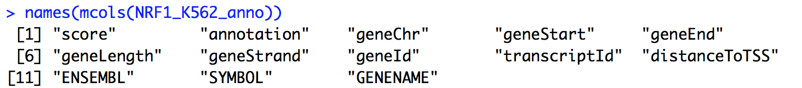
Peak information

Slide 45
Plots

Slide 46
Bar plot of the number of peaks
input is the length of the three GRanges datasets
length indicating the total number of peaks for each dataset.
c() creates a vector in R
Used to allow the 3 lengths to be a single input
names renames the labels on the x-axis
Use the c() command to make a vector
Order MUST match

Slide 47
Overlapping Peaks
Create a weighted Venn diagram for overlapping peaks
Use findOverlapsOfPeaks from ChIPpeakAnno
input → GRanges files
Can be more than 1

Slide 48
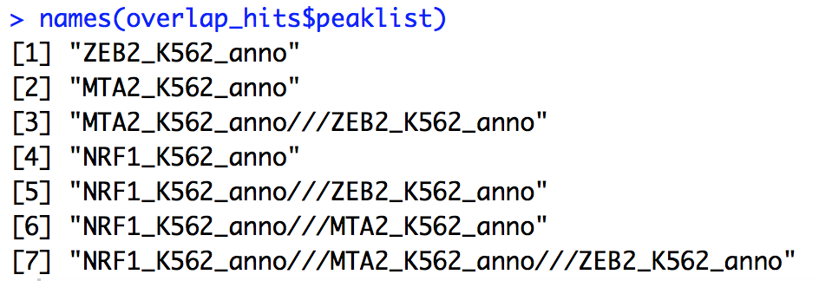
Overlapping Peaks
findOverlapsOfPeaks returns a list called overlap_hits containing:
peaklist in overlap_hits is also a list containing:
length of each peaklist → number of peaks in each category

Slide 49
Create weighted Venn
Using the Venn function from the Vennerable package in R
Options:
SetNames → Names for each Circle in Venn
Weights → Size of each portion
Order is important!
With 3 datasets, the order in weights is:
Dataset1,
Dataset2,
Overlap of Dataset1 and Dataset2,
Dataset3,
Overlap of Dataset1 and Dataset3,
Overlap of Dataset2 and Dataset3,
Overlap of Dataset1 Dataset2 and Dataset3

Slide 50
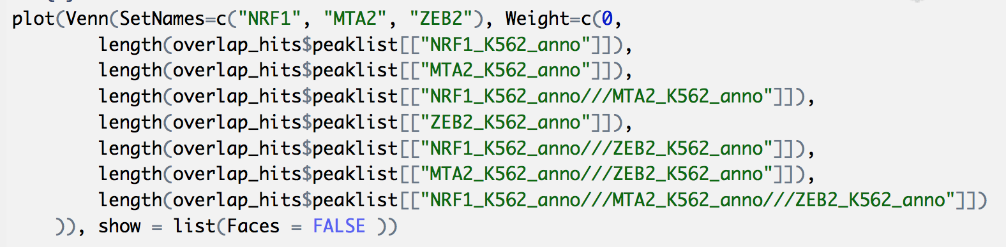
Weighted Venn

Slide 51
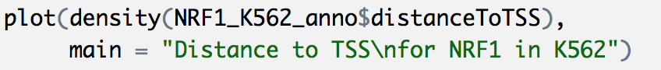
Distribution around TSS
Annotate file contains columns called : distanceToTSS
Need to create a density plot

Slide 52
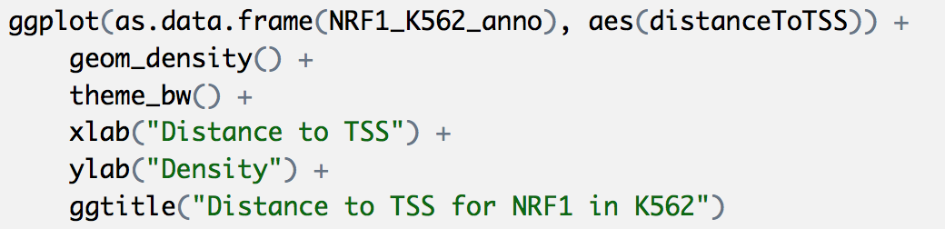
Distribution around TSS using ggplot2

Slide 53
PRACTICAL
Make distribution to TSS plot

Slide 54
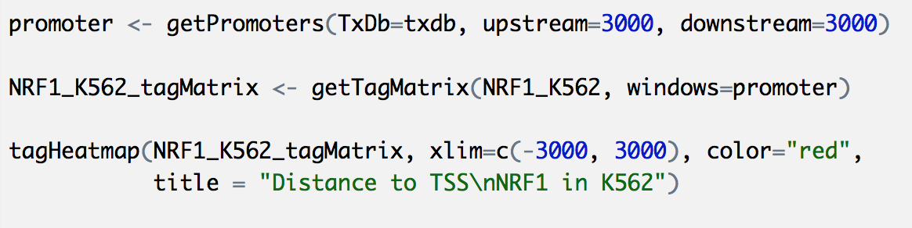
Heatmaps
Using ChIPseeker package in R

Slide 55
PRACTICAL
Make distribution to heatmap TSS plot

Slide 56
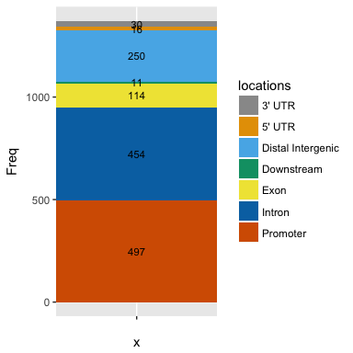
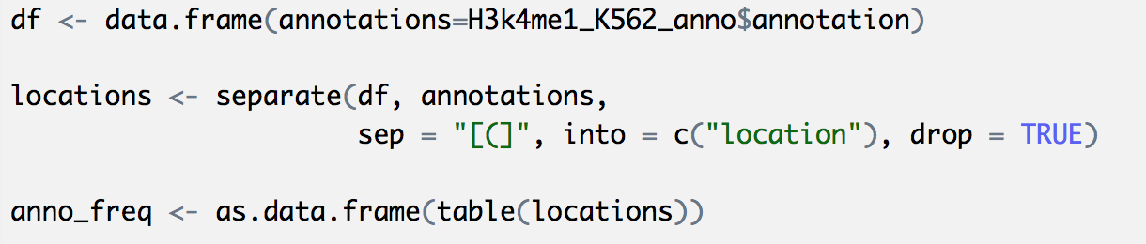
Stacked bar plot of genomic annotations
Hardest part – getting the data in the correct format for plotting
Need data frame # of occurrences per genomic location

Slide 57
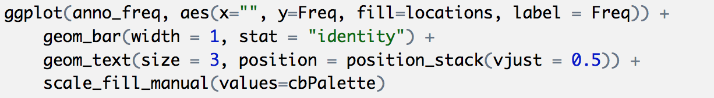
Stacked bar plot of genomic annotations
Notice : can have 2 geoms
ggplot2 has LOTS of options
Get plots to look exactly as you want

Slide 58
Create a genomic location map
Using the Gviz package from Bioconductor
Works by building individuals “tracks” and then plotting them together
Tracks:
Annotation
Gene Region
Data
Ideogram
Genome Axis
Sequence

Slide 59
Gene Region Track
Get gene information for plotting
Start, stop, exon start, exon stop, direction, name, etc.
Use biomaRt to get data from Ensembl
Two steps:
(1) Connect to BioMart database and dataset
(2) Extract information

Slide 60
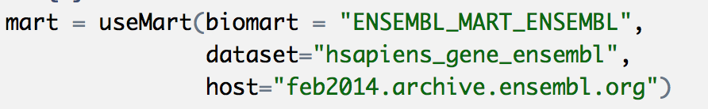
Gene Region Track – Connect to BioMart database and dataset
biomart → “ENSEMBL_MART_ENSEMBL”
database to connect to
dataset → “hsapiens_gene_ensembl”
host → “feb2014.archive.ensembl.org”
Data is on genome build hg19, therefore the host is an archived version of Ensembl from Feb 2014, which relates to the hg19 build.

Slide 61
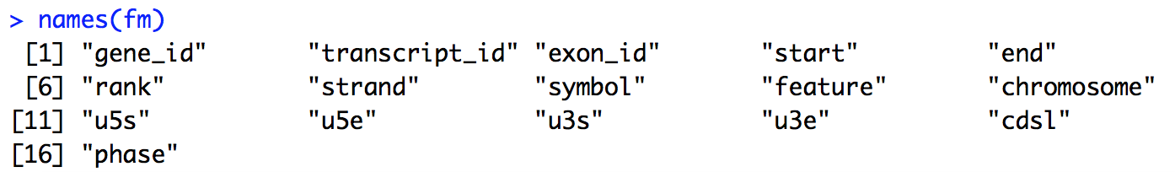
Gene Region Track – Extract information
.getBMFeatureMap – all the data required by Gviz for creating plot.

Slide 62
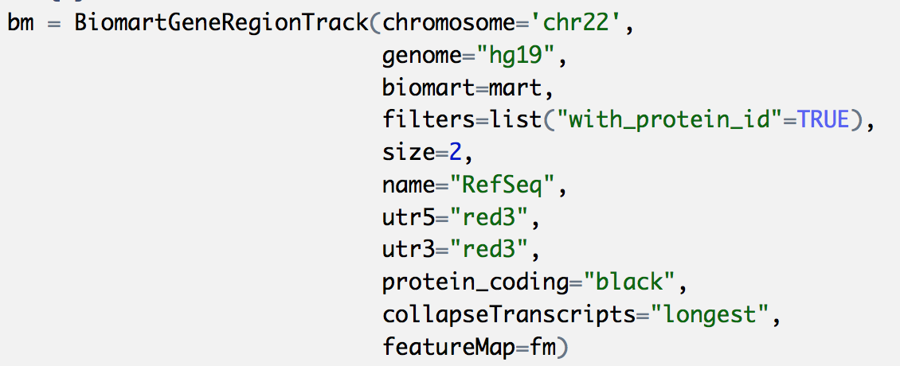
Gene Region Track – Extract information
BiomartGeneRegionTrack function from Gviz extracts the data from BioMart and formats it for plotting in Gviz

Slide 63
Data Track
input → GRanges object
genome → what genome the data is
name → what you want to call the track in the plot
ylim → sets the range for the y-axis.
Plotting multiple tracks always set the range for each plot to be the same
Makes data easier to interpret

Slide 64
IdeogramTrack and GenomeAxisTrack
GenomeAxisTrack adds a track with mb location information
IdeogramTrack adds a track with a chromosome ideogram

Slide 65
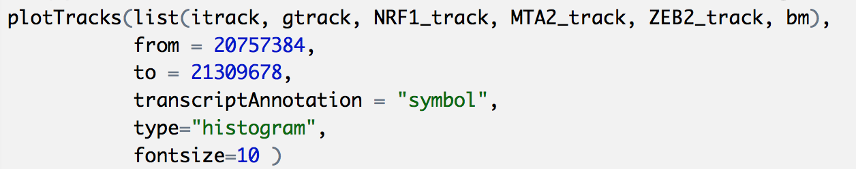
Putting it all together
input → list of all the tracks
Order of this list is the order they will appear in the plot
from & to → set the region to be plotted
transcriptAnnotation → adds information to the gene track
type → sets type of plot to use
a lot of options for this, refer to the Gviz manual for more information
fontsize → sets the size of the text in the plot

Slide 66
Genome location map

Slide 67
Good packages for ChIPseq data in R
ChIPpeakAnno
http://bioconductor.org/packages/release/bioc/html/ChIPpeakAnno.html
ChIPseeker
http://bioconductor.org/packages/release/bioc/html/ChIPseeker.html
Genomation
https://bioconductor.org/packages/release/bioc/html/genomation.html
Gviz
http://bioconductor.org/packages/release/bioc/html/Gviz.html
Ggbio
https://bioconductor.org/packages/release/bioc/html/ggbio.html
Good basic plotting package for R:
Ggplot2 : http://ggplot2.org/

